Slide 1
Deadline-Constrained Accelerator Design for Image Processing
Blake Wang and Yu Cheng Wu, CSEN 318 Final Project
Finding the lowest-energy systolic array that still meets a real-time frame deadline
Notes:
Hi everyone, I'm Blake, and with my partner Yu Cheng Wu, our final project is titled Deadline-Constrained Accelerator Design for Image Processing. The one-line version goes like this. If an embedded camera has to run an image-processing pipeline on every single frame, what hardware accelerator should we build to hit a real-time deadline while burning the least energy? Over the next few slides I'll walk you through the workload, how we model it, the design space we searched, and what we found.

Slide 2
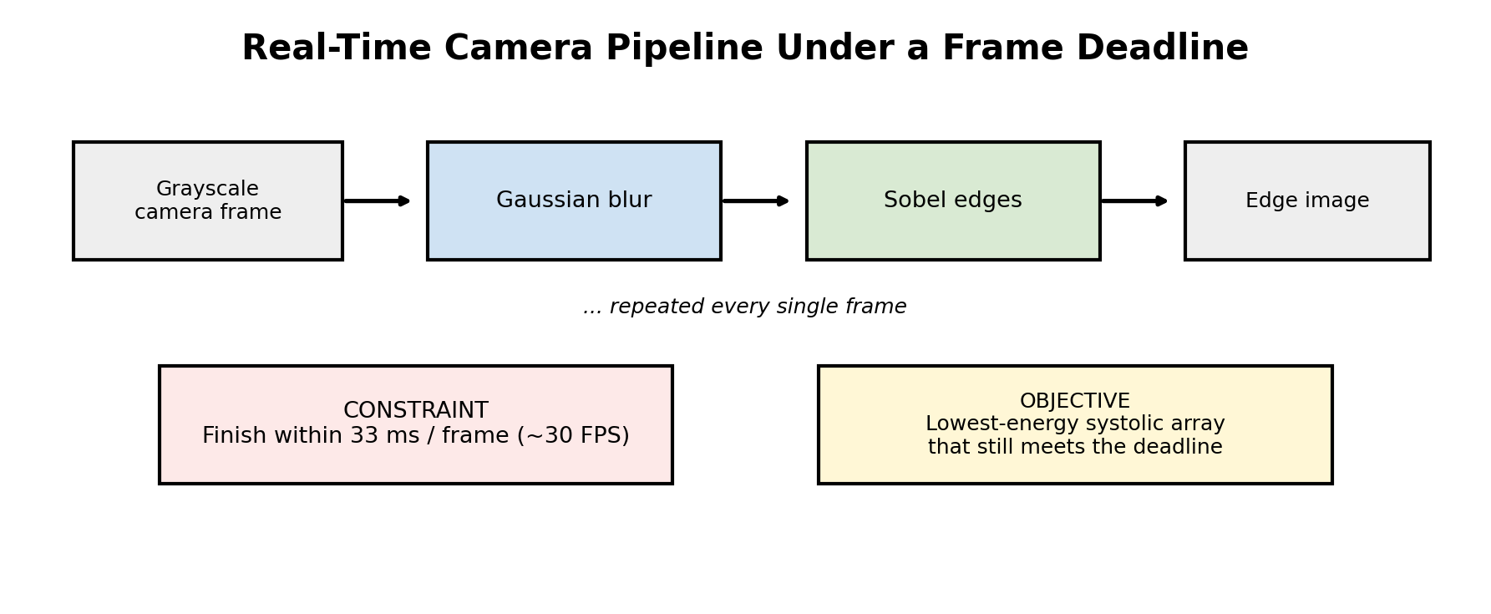
Problem Statement
We model a hardware accelerator for a real-time image-processing service, not image quality itself.
A grayscale camera must process every frame through Gaussian blur and then Sobel edge detection.
Real-time mode means each frame has to finish within 33 ms, which is roughly 30 frames per second.
Our goal is the lowest-energy systolic array that still meets that frame deadline.
Notes:
Let me frame the problem. This project is not really about making an image look nicer. It is about modeling the hardware that runs a real-time image-processing service. The scenario is concrete. A grayscale camera pipeline has to process each frame periodically, running a Gaussian blur followed by Sobel edge detection. For real-time operation the system must finish every frame within 33 milliseconds, which corresponds to about 30 frames per second. So the question we are answering is an architecture question. Among all the systolic-array designs that can meet that 33-millisecond deadline, which one uses the least energy? That single trade-off, meeting the deadline while minimizing energy, drives the entire project.

Slide 3
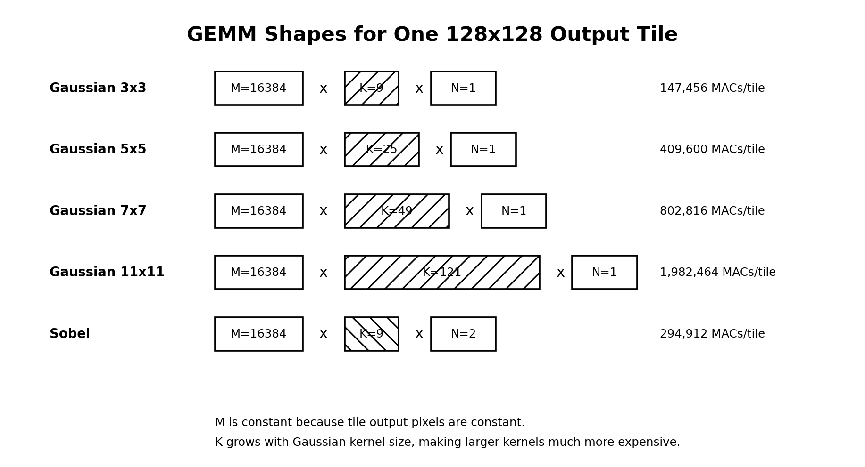
Why This Workload is Interesting
Gaussian blur and Sobel are classic DSP and embedded-vision filters that touch every pixel in the frame.
We sweep four Gaussian kernel sizes, namely 3x3, 5x5, 7x7, and 11x11.
A bigger kernel uses far more neighbors per output pixel, from 9 values at 3x3 up to 121 at 11x11.
Compute per tile grows accordingly, so the 11x11 case is more than ten times heavier than 3x3.
Notes:
Why is this workload interesting from an architecture standpoint? Gaussian blur smooths the image to reduce noise, and Sobel finds edges by detecting sharp brightness changes. These are textbook DSP and embedded-vision operations, simple enough to model cleanly but meaningful because they touch every pixel in the frame. The interesting knob is the Gaussian kernel size, which we sweep across 3x3, 5x5, 7x7, and 11x11. The bigger the kernel, the more neighboring pixels feed each output pixel. That goes from nine values at 3x3, to twenty-five at 5x5, to forty-nine at 7x7, and one hundred twenty-one at 11x11. As you can see on the right, the number of multiply-accumulate operations per tile explodes with kernel size. The 11x11 case is roughly two million MACs per tile, more than ten times the 3x3 case. Sobel, by contrast, stays fixed at a 3x3 footprint. That growing imbalance is what makes the design problem non-trivial.

Slide 4
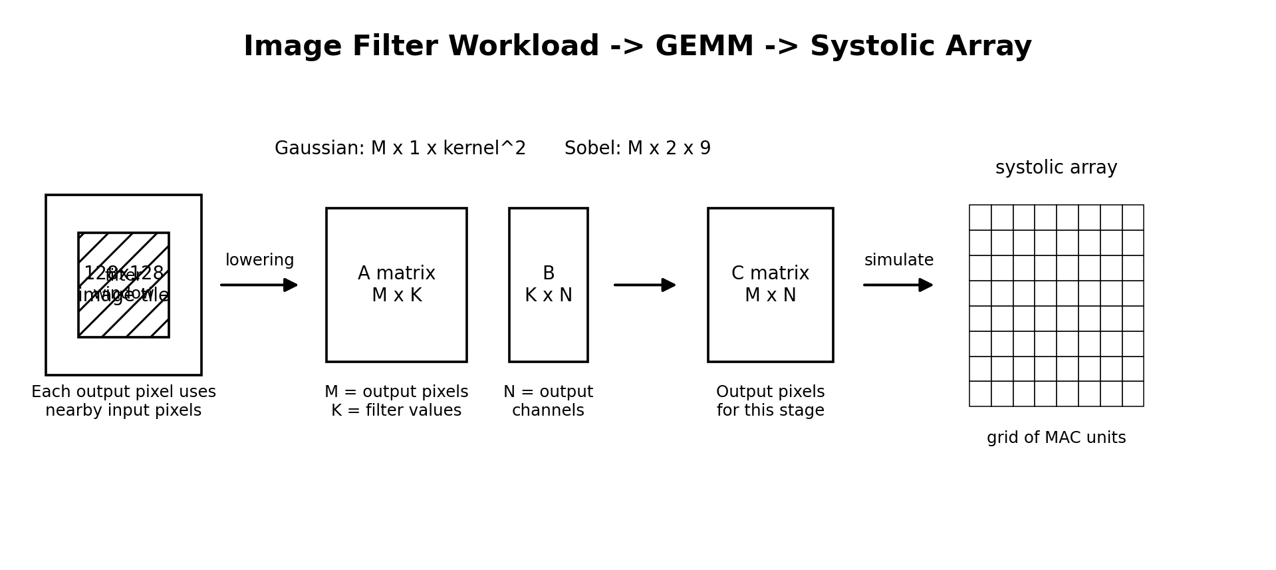
Mapping Image Filters to GEMM
Each output pixel is a dot product of a pixel neighborhood with the filter weights.
A whole tile of these dot products becomes one matrix multiply, also called GEMM.
Gaussian maps to M output pixels, N equal to 1, and K equal to kernel-size squared.
Sobel maps to M output pixels, N equal to 2 for horizontal and vertical gradients, and K equal to 9.
This lowering is the bridge that lets us run image filters on a systolic-array simulator.
Notes:
To run these filters on a systolic array, we first convert them into matrix multiplication. Here is the idea. For each output pixel, a filter takes a small neighborhood of input pixels, multiplies each by a weight, and sums them, which is exactly a dot product. A large collection of dot products is itself a matrix multiply, or GEMM. We lower each filter into an M-by-K times K-by-N matrix multiply. For Gaussian, M is the number of output pixels in the tile, N is one, and K is the kernel size squared. For Sobel, M is again the output pixels, but N is two because Sobel computes both a horizontal and a vertical gradient, and K is nine. This lowering step is the crucial bridge. Once the workload is in GEMM form, we can feed it straight into a systolic-array simulator, which is what the array on the right represents.

Slide 5
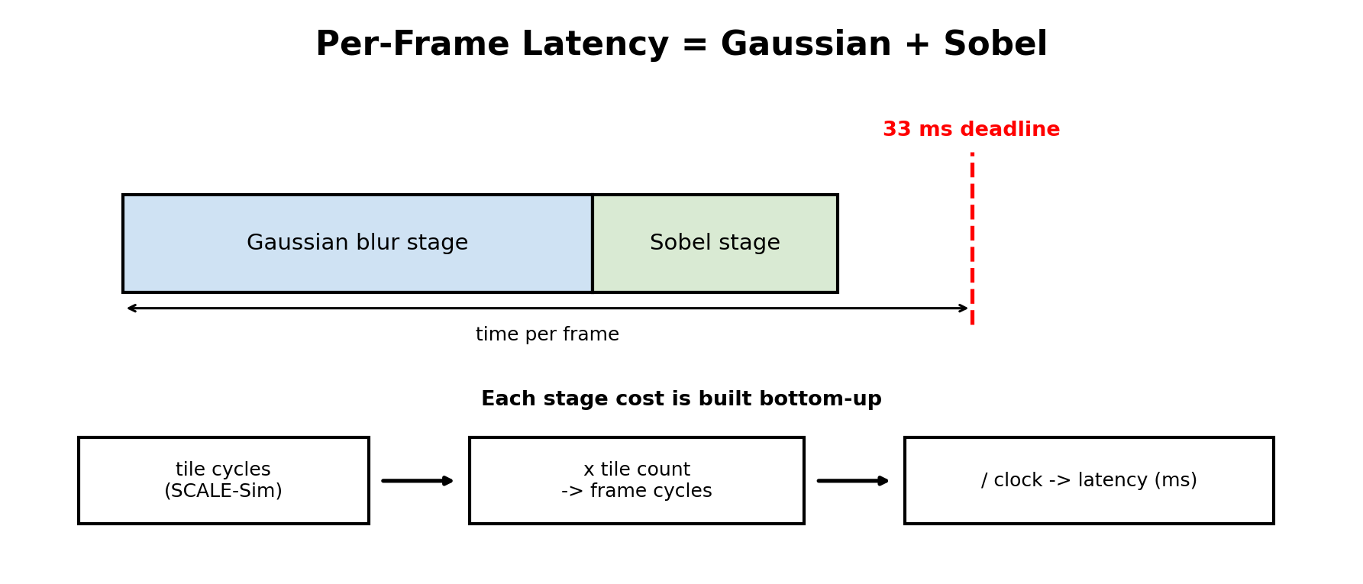
End-to-End Performance Modeling
Per-frame latency is the Gaussian stage time plus the Sobel stage time.
We build each stage cost from the bottom up, starting from SCALE-Sim cycles for one tile.
Tile cycles times tile count gives total frame cycles.
Dividing frame cycles by the clock gives latency in milliseconds, which we compare against the deadline.
Notes:
Now, how do we turn that into an end-to-end performance number? The full-frame latency is simply the Gaussian stage plus the Sobel stage, since the two filters run back-to-back on every frame. We build each stage cost from the bottom up. SCALE-Sim tells us how many cycles one representative tile takes on a given array. We multiply tile cycles by the number of tiles to get total frame cycles, and then divide by the clock frequency to get latency in milliseconds. That single per-frame latency number is what we check against the 33, 100, or 200 millisecond deadlines. So everything reduces to one question. Does Gaussian plus Sobel finish in time, and at what energy cost?

Slide 6
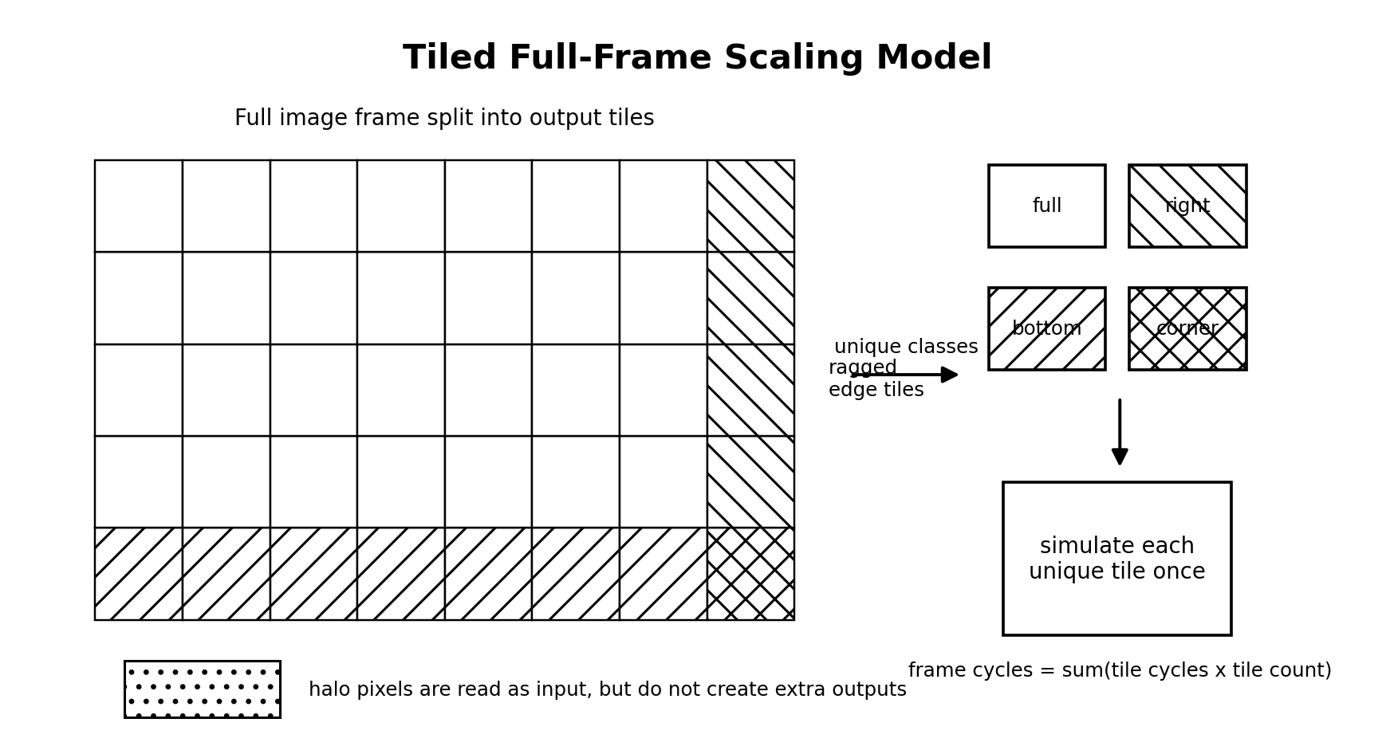
Tiled Simulation Strategy
A 1080p frame has over two million pixels, and we sweep thousands of design combinations.
Simulating every full frame directly would be far too slow.
Instead we simulate representative 128x128 tiles and scale the results up to the full frame.
We model four tile classes, namely interior, right-edge, bottom-edge, and corner, to handle ragged frame sizes.
Halo pixels are read from just outside each tile but produce no extra outputs, so they add input traffic only.
Notes:
A practical problem is that a 1080p frame has more than two million pixels, and we are sweeping resolutions, kernel sizes, array sizes, SRAM budgets, bandwidths, and dataflows, which is thousands of combinations. Simulating every full frame directly would be prohibitively slow. So we use tiling. We simulate representative 128-by-128 tiles and then scale those results up to the full frame. Most tiles are full interior tiles, but frames do not always divide evenly into 128-pixel chunks, so we also model right-edge, bottom-edge, and corner tile classes. One subtlety is the halo. To compute pixels near a tile's border, the filter needs input pixels just outside the tile. Those halo pixels increase input memory traffic but do not create extra output pixels, and that asymmetry matters because memory traffic drives energy. Frame cost is then the sum over tile classes of tile cost times tile count.

Slide 7
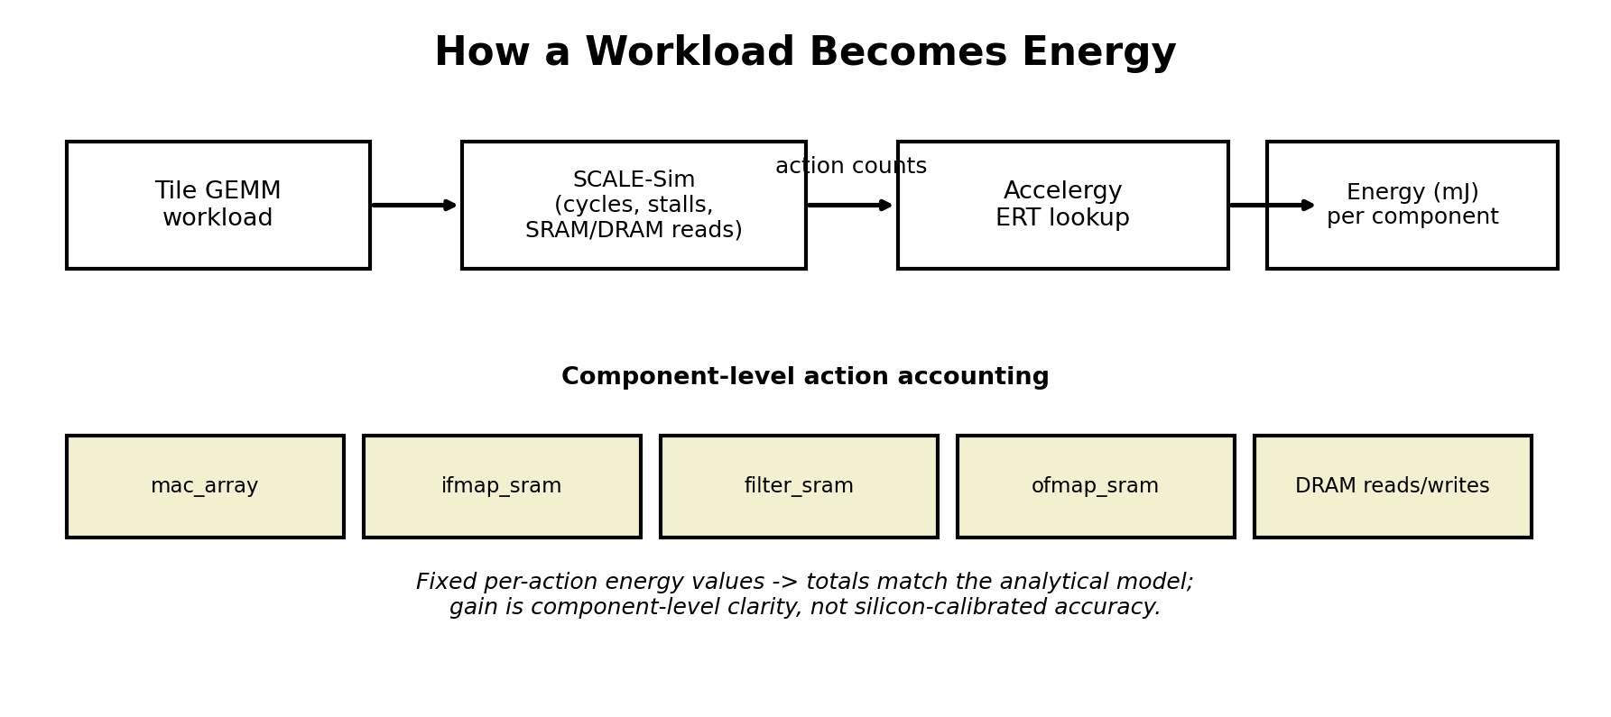
SCALE-Sim and Accelergy Pipeline
SCALE-Sim is the performance model, reporting cycles, stalls, utilization, and SRAM and DRAM accesses per tile.
Those access counts become per-component action counts for the energy model.
Accelergy maps each action through an Energy Reference Table to get energy per component.
Energy is split across the MAC array and the ifmap, filter, and ofmap SRAM and DRAM paths.
Because per-action values are fixed, totals match our analytical model, so the gain is component-level clarity rather than silicon accuracy.
Notes:
Here is the toolflow that produces those numbers. SCALE-Sim is the performance simulator. For each tile and hardware configuration it reports cycle count, stall cycles, utilization, and detailed SRAM and DRAM read and write counts. We take those access counts and treat them as action counts, which we feed into Accelergy for energy accounting. Accelergy looks up each action in an Energy Reference Table and gives us energy broken down by component, including the MAC array, the input, filter, and output SRAMs, and the corresponding DRAM paths. We deliberately kept this table-based rather than pulling in CACTI or Timeloop, to keep the project finishable. One honest caveat I will state up front. Because the table uses fixed per-action energy values, the totals match our original analytical model. The improvement is methodological, namely clean component-level action accounting, rather than silicon-calibrated accuracy. The comparisons are relative, and that is enough to answer our design question.

Slide 8
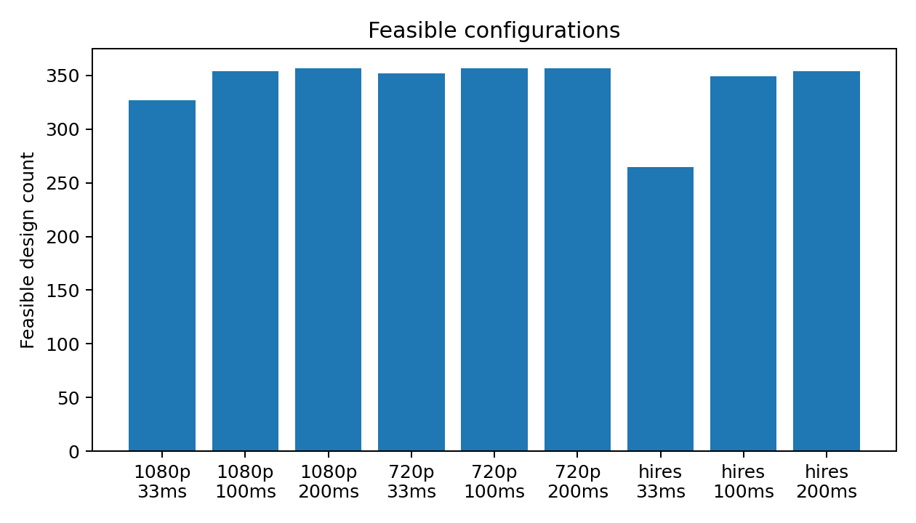
Design Space
We sweep 3 resolutions, namely 720p, 1080p, and 2048x2048, plus 3 deadlines of 33, 100, and 200 ms.
Hardware knobs include 5 array sizes from 8x8 to 128x128, 3 SRAM budgets, 3 bandwidths, and 2 dataflows.
That gives 90 hardware configurations per workload and 360 designs per resolution.
Most designs are feasible at relaxed deadlines, while the 33 ms real-time target is the binding constraint.
At 1080p, 327 of 357 configurations meet 33 ms, versus all 357 at 200 ms.
Notes:
This slide shows the design space we searched. On the workload side we vary three resolutions, which are 720p, 1080p, and 2048-by-2048, three deadlines of 33, 100, and 200 milliseconds, and the four Gaussian kernel sizes. On the hardware side we vary five array sizes from 8-by-8 up to 128-by-128, three SRAM budgets, three memory bandwidths, and two dataflows. That works out to ninety hardware configurations per workload and three hundred sixty designs per resolution. The chart on the right counts how many configurations are feasible for each resolution and deadline combination. The key reading is that at the relaxed 100 and 200 millisecond deadlines almost everything is feasible, but the 33-millisecond real-time target is the binding constraint. At 1080p, 327 of 357 configurations make it, and the highest-resolution case is the hardest. So the deadline is what actually prunes the space.

Slide 9
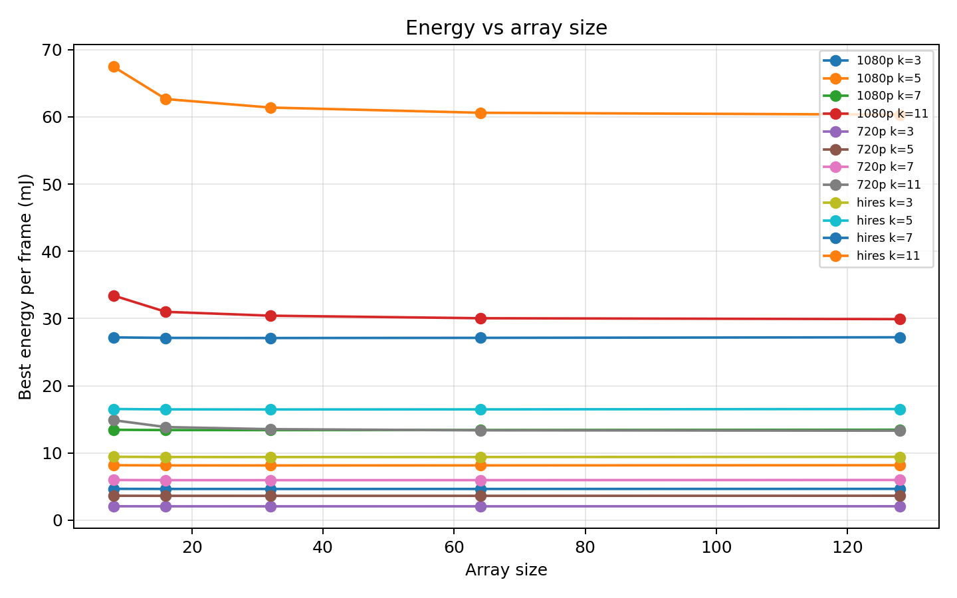
Main Results
The headline is the minimum-energy feasible design at 1080p under a 33 ms deadline.
At 3x3 Gaussian the winner is a 32x32 output-stationary array, 10.07 ms and 4.64 mJ.
At 5x5 it stays 32x32 output-stationary, 11.77 ms and 8.14 mJ.
At 7x7 it stays 32x32 output-stationary, 14.32 ms and 13.40 mJ.
At 11x11 it flips to 128x128 weight-stationary, 7.62 ms and 29.91 mJ.
Small and medium filters favor a modest 32x32 array, while only the heavy 11x11 justifies 128x128.
Notes:
Here are the main results, the central story of the project. For 1080p at the 33-millisecond deadline, these are the lowest-energy designs that still meet the deadline. For the 3x3 Gaussian, a 32-by-32 output-stationary array wins at about 10 milliseconds and 4.6 millijoules. For 5x5 it is again 32-by-32 output-stationary, around 11.8 milliseconds and 8.1 millijoules. For 7x7, still 32-by-32 output-stationary, 14.3 milliseconds and 13.4 millijoules. But for the heavy 11x11 kernel, the winner flips to a 128-by-128 weight-stationary array at 7.6 milliseconds and 29.9 millijoules. The takeaway is that for small and medium filters a modest 32-by-32 array is both fast enough and the most energy-efficient, and going bigger does not help. Only when the workload gets heavy, at 11x11, does the large 128-by-128 array start to pay for itself. The energy chart on the right reinforces this. Best-case energy is nearly flat across array sizes, so a bigger array rarely buys you lower energy.

Slide 10
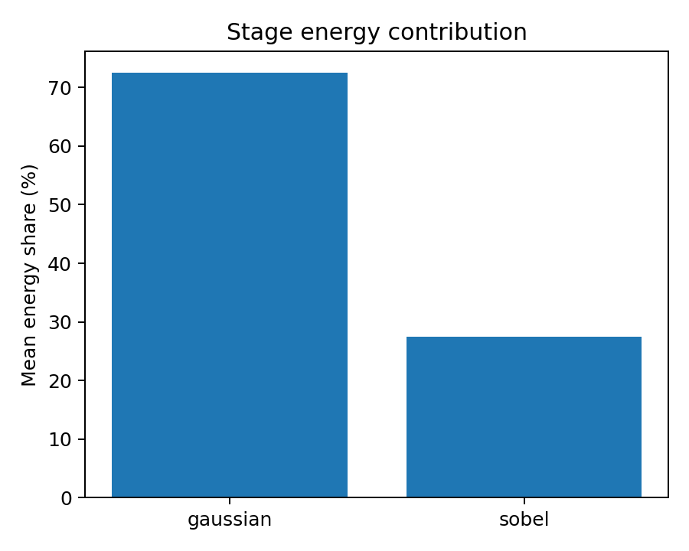
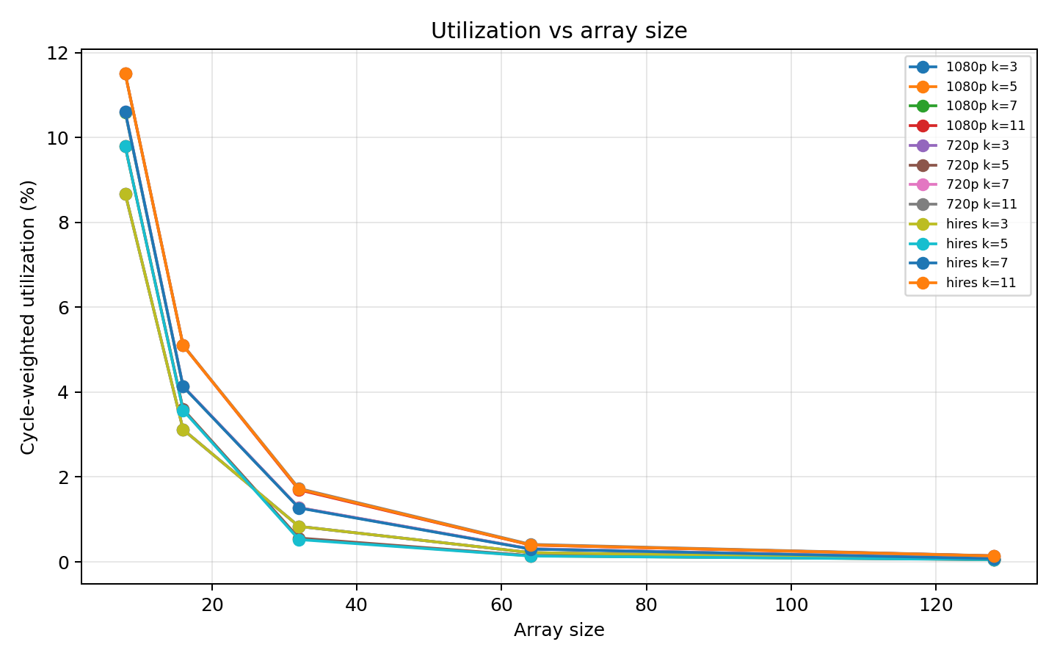
Bottlenecks + Discussion
Gaussian dominates the pipeline, with its energy share climbing from about 48% at 3x3 to about 91% at 11x11, because Sobel stays a fixed 3x3.
Array utilization stays very low, often under 12%, because these filters are skinny GEMMs with N of 1 or 2, and that is the real bottleneck rather than raw compute.
Notes:
Where do the time and energy actually go? Two findings. First, Gaussian is the bottleneck stage. Because Sobel is fixed at 3x3 while Gaussian grows, Gaussian's share of total energy climbs from about 48 percent at 3x3, to 70 percent at 5x5, to 81 percent at 7x7, and to roughly 91 percent at 11x11. The left chart shows Gaussian averaging around 72 percent of energy overall. The practical implication is that for large kernels, optimizing Sobel barely moves the needle, since Gaussian is where the effort should go. Second, and more architecturally interesting, the array is badly underutilized. The right chart shows cycle-weighted utilization is often under 12 percent and collapses toward zero on the big arrays. That happens because these image filters lower to skinny GEMMs with N equal to one or two, so a large square array sits mostly idle. The bottleneck is not raw compute throughput. It is that the workload shape cannot fill a big array. That is the real lesson hiding under the numbers.

Slide 11
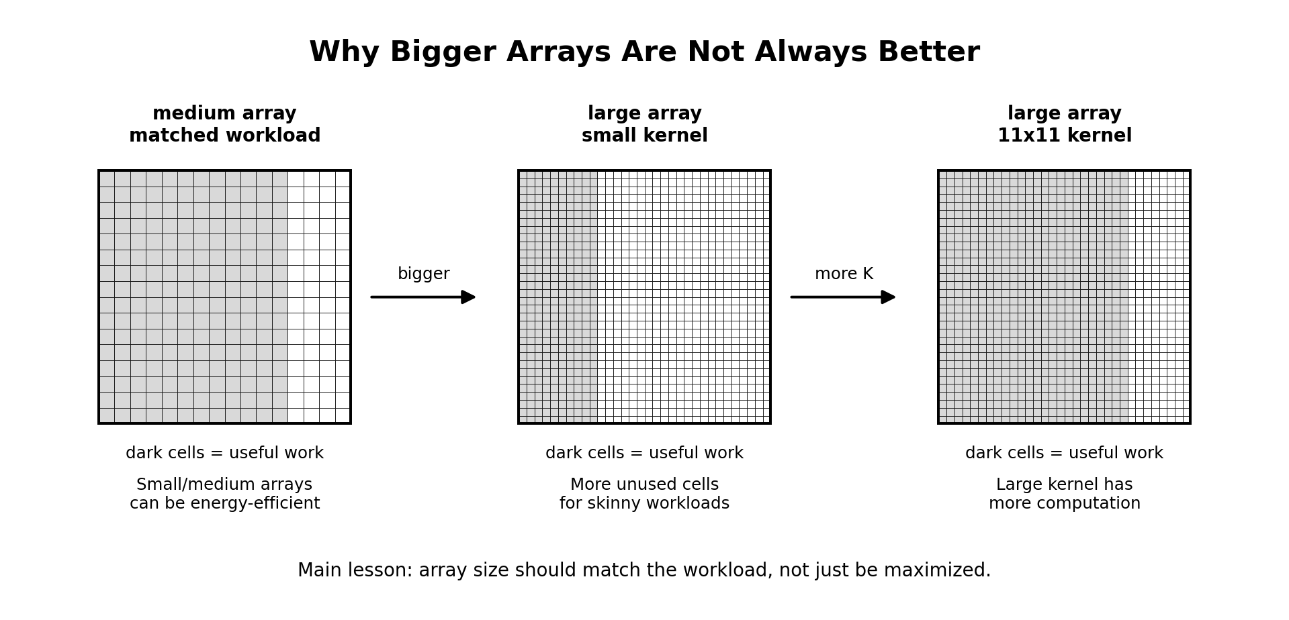
Takeaways
Bigger hardware is not always better, since array size should match the workload rather than be maximized.
A 32x32 output-stationary array is the sweet spot for 3x3, 5x5, and 7x7 filters at 1080p and 33 ms.
Only the heavy 11x11 kernel justifies a 128x128 weight-stationary array.
Gaussian dominates energy and latency, and skinny GEMMs leave large arrays underutilized.
Known limits include grayscale only, tile-based scaling, and table-based relative energy rather than silicon-calibrated.
Notes:
To wrap up, the single biggest lesson is that bigger hardware is not always better. The energy-optimal array size should match the workload rather than simply being maximized. Concretely, a 32-by-32 output-stationary array is the sweet spot for the 3x3, 5x5, and 7x7 filters at 1080p and 33 milliseconds, and only the heavy 11x11 kernel makes a 128-by-128 weight-stationary array worthwhile. Underneath that, Gaussian dominates both energy and latency, and because these filters are skinny GEMMs, large arrays end up underutilized. I want to be honest about scope. We evaluate grayscale 8-bit images only, we use tile-based scaling instead of full-frame simulation, and our energy numbers are table-based relative comparisons rather than silicon-calibrated measurements. Those define the boundaries of the claims, but within them the conclusion is clear. Match the accelerator to the workload. Thank you, and I am happy to take questions.

